Slide 1



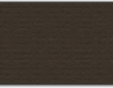
NNFL Group project

Slide 2
Assigned TA -
Honnesh Rohmetra
Group Members –
Sanjeev Singla I.D. - 2017A8PS0152P
Swastik Mohanty I.D. - 2017A8PS0282P
Paper I.D. -
CATEGORIES
CNN
Semantic Segmentation
Encoder-Decoder
71
Course Instructors
Prof. Surekha Bhanot
Prof. Bijoy Krishna Mukherjee

Slide 3
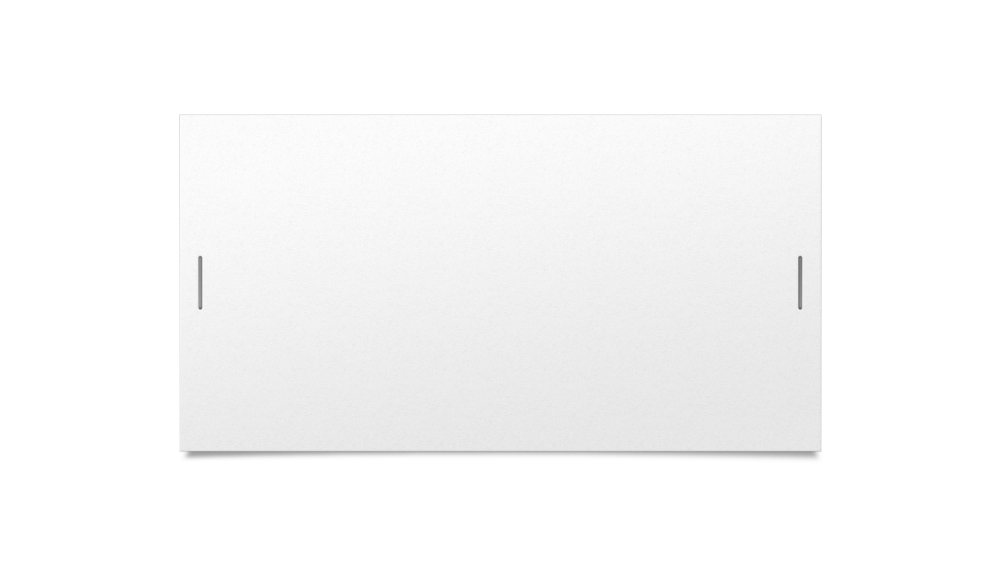
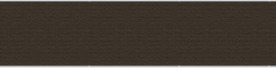
U-Net: Convolutional Networks for Biomedical Image Segmentation
Problem Statement that U-net aims to solve is Semantic Segmentation In layman terms - segmentation is a computer vision task in which we label specific regions of an image according to what's being shown. More specifically, the goal of semantic image segmentation is to label each pixel of an image with a corresponding class of what is being represented. This is important as it makes images easier to analyze by assigning parts of the image semantic definitions.

Slide 4
U-Net Model
U-Net is a convolutional neural network that was developed for biomedical image segmentation. It consists of a contracting path and an expansive path, which gives it the u-shaped architecture.
Contraction path consists of a repeated application of a 3x3 convolutions(unpadded) each followed by a ReLU and a 2x2 max pooling operation with stride 2 for downsampling. At each downsampling step, we double the number of feature channels. This captures context via a compact feature map.
The expansion path consists of upsampling of the feature map followed by a 2x2 convolution(“up-convolution”) that halves the number of feature channels a concatenation with the cropped feature map from the contracting path, and a 3x3 convolutions, followed by a ReLU. The upsampling of the feature dimension is done to meet the same size as the block to be concatenated on the left.

Slide 5

Network Architecture

Slide 6
Data - DRIVE Dataset

Slide 7
The photographs for the DRIVE database were obtained from a diabetic retinopathy screening program in The Netherlands. The screening population consisted of 400 diabetic subjects between 25-90 years of age. Forty photographs have been randomly selected, 33 do not show any sign of diabetic retinopathy and 7 show signs of mild early diabetic retinopathy.
Each image has been JPEG compressed. The images were acquired using a Canon CR5 non-mydriatic 3CCD camera with a 45-degree field of view (FOV). Each image was captured using 8 bits per color plane at 768 by 584 pixels. The FOV of each image is circular with a diameter of approximately 540 pixels. For this database, the images have been cropped around the FOV. For each image, a mask image is provided that delineates the FOV.

Slide 8

Changes / Modifications
The dataset does not include 1st manual and 2nd manual images for testing the test set.
This is because the website asks us to enter the competition and test the model themselves.
We have divide the training set again to make a new test set to solve this problem.
We have also tried other data augmentation techniques to increase the test data set size but we didn't get any promising results.

Slide 9
Pre – Processing

Slide 10
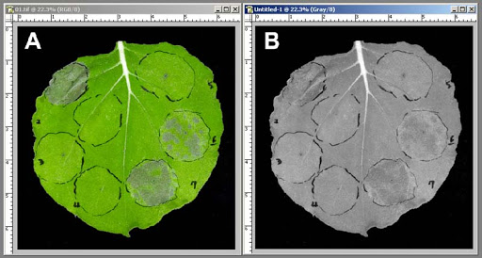
Grey-scale Conversion

Slide 11
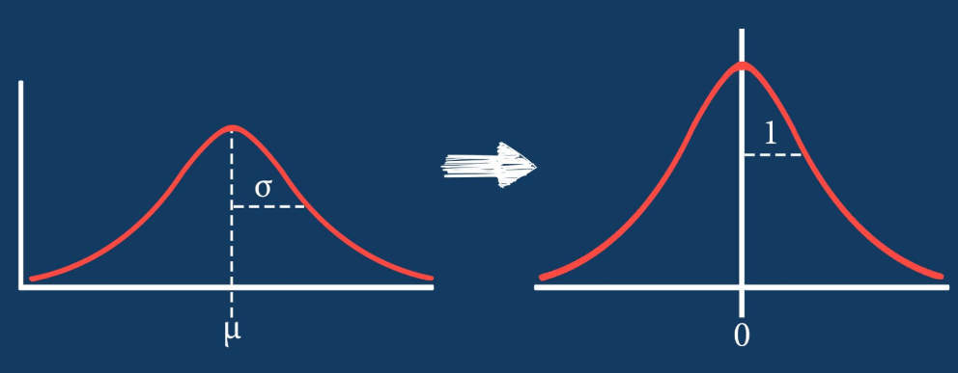
Standardization

Slide 12
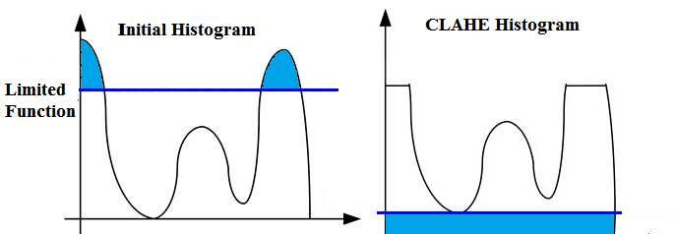
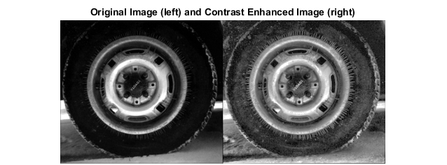
Contrast-limited adaptive histogram equalization (CLAHE)

Slide 13
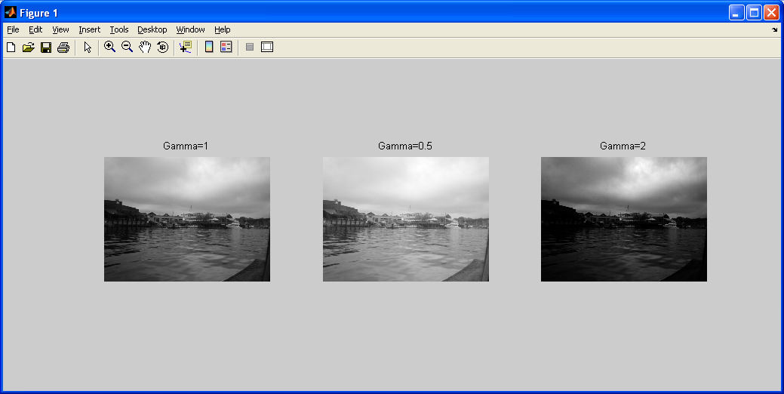
Gamma adjustment

Slide 14
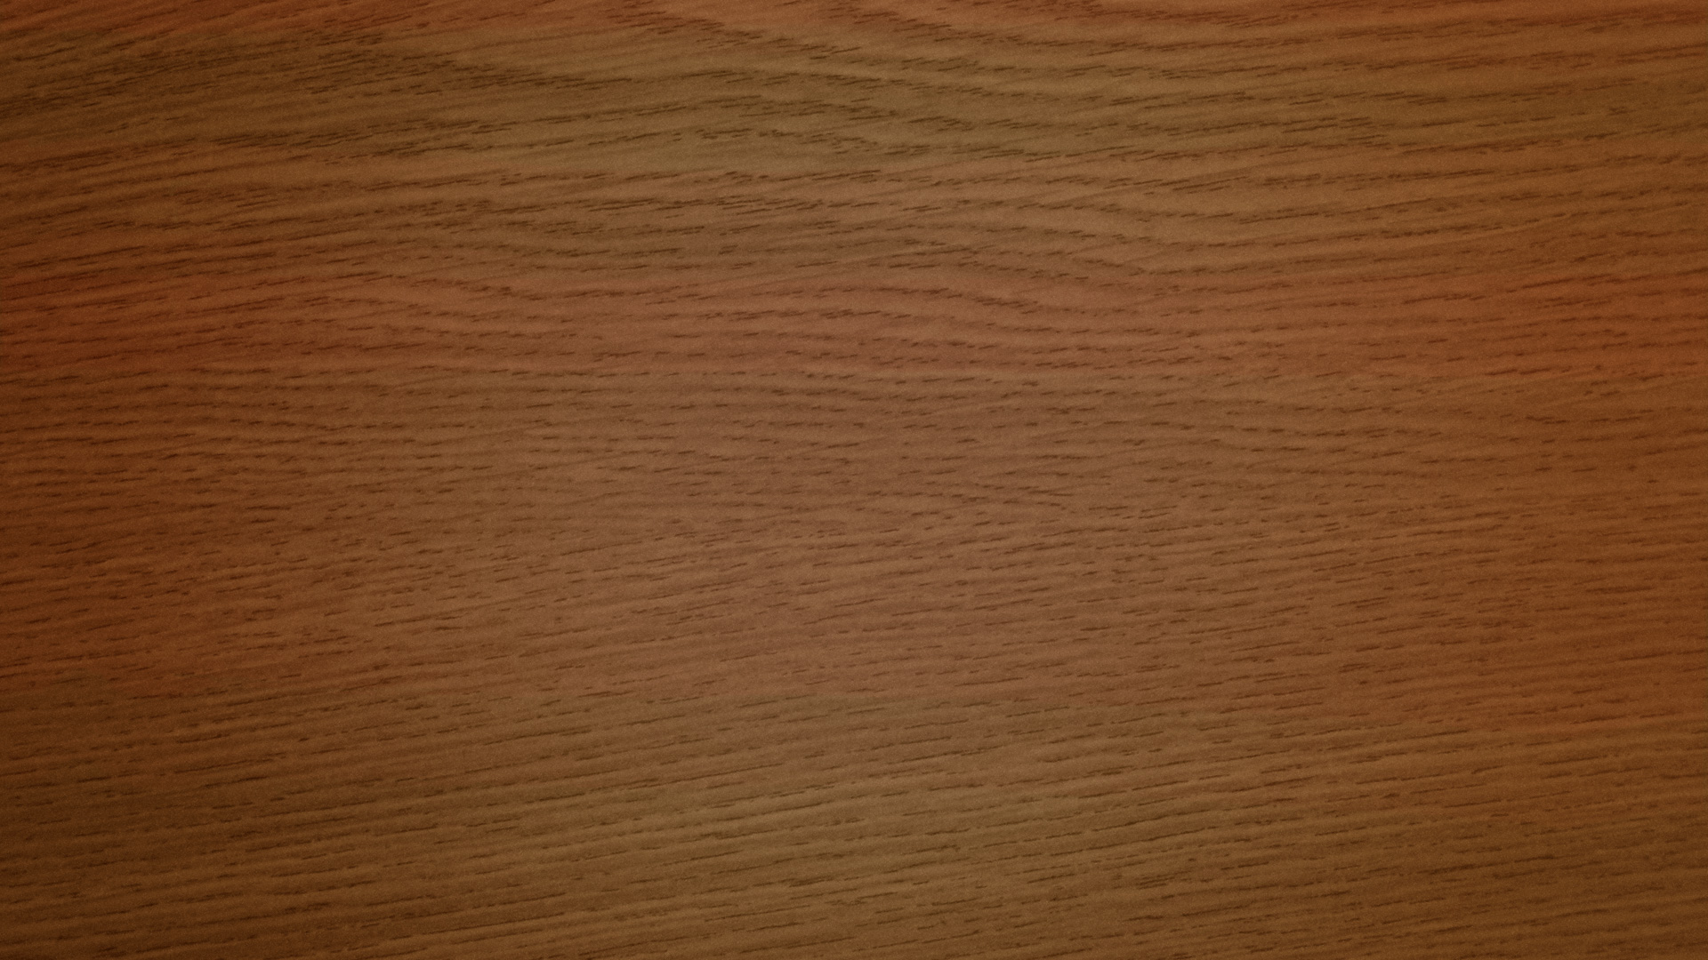
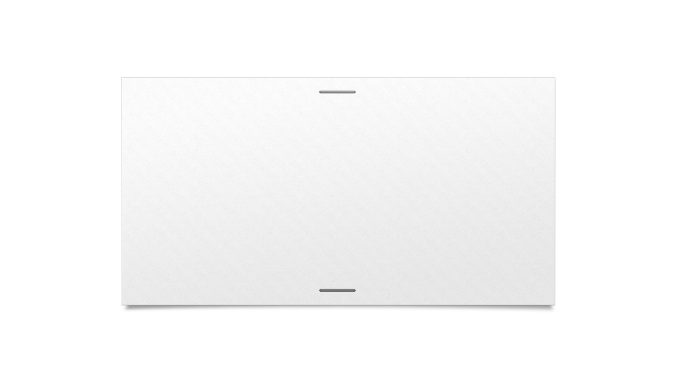
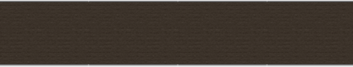
Results

Slide 15
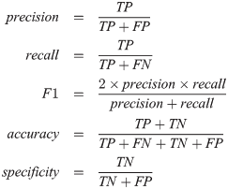
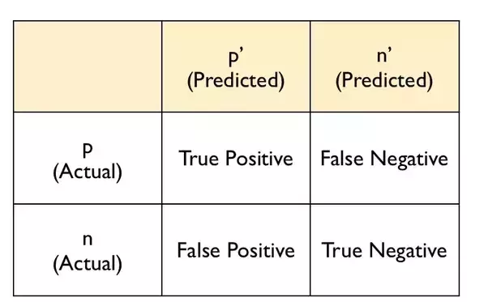
Quantitative Results
ACCURACY: 0.955983978469
RECALL: 0.767137136912
SPECIFICITY: 0.98352781244
PRECISION: 0.871673216962
F1 SCORE: 0.816071114516

Slide 16
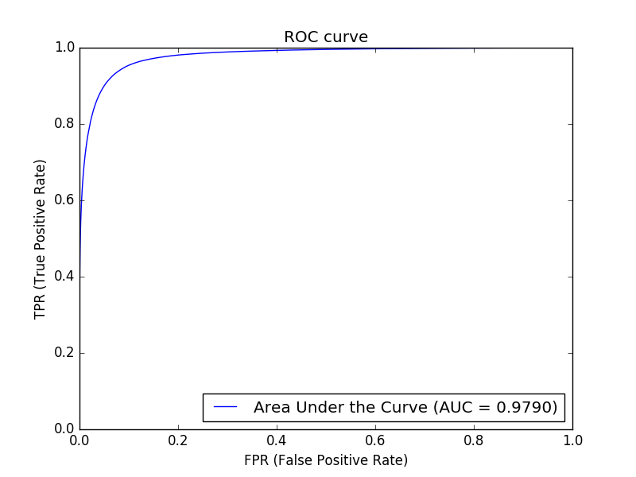
ROC Curve

Slide 17
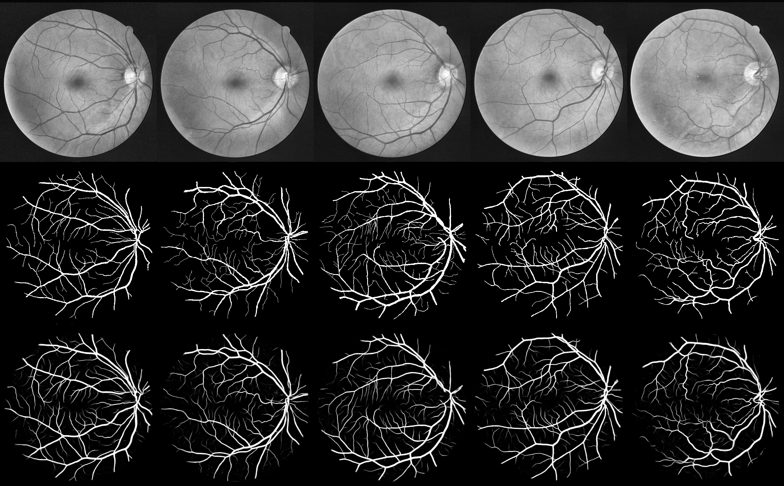
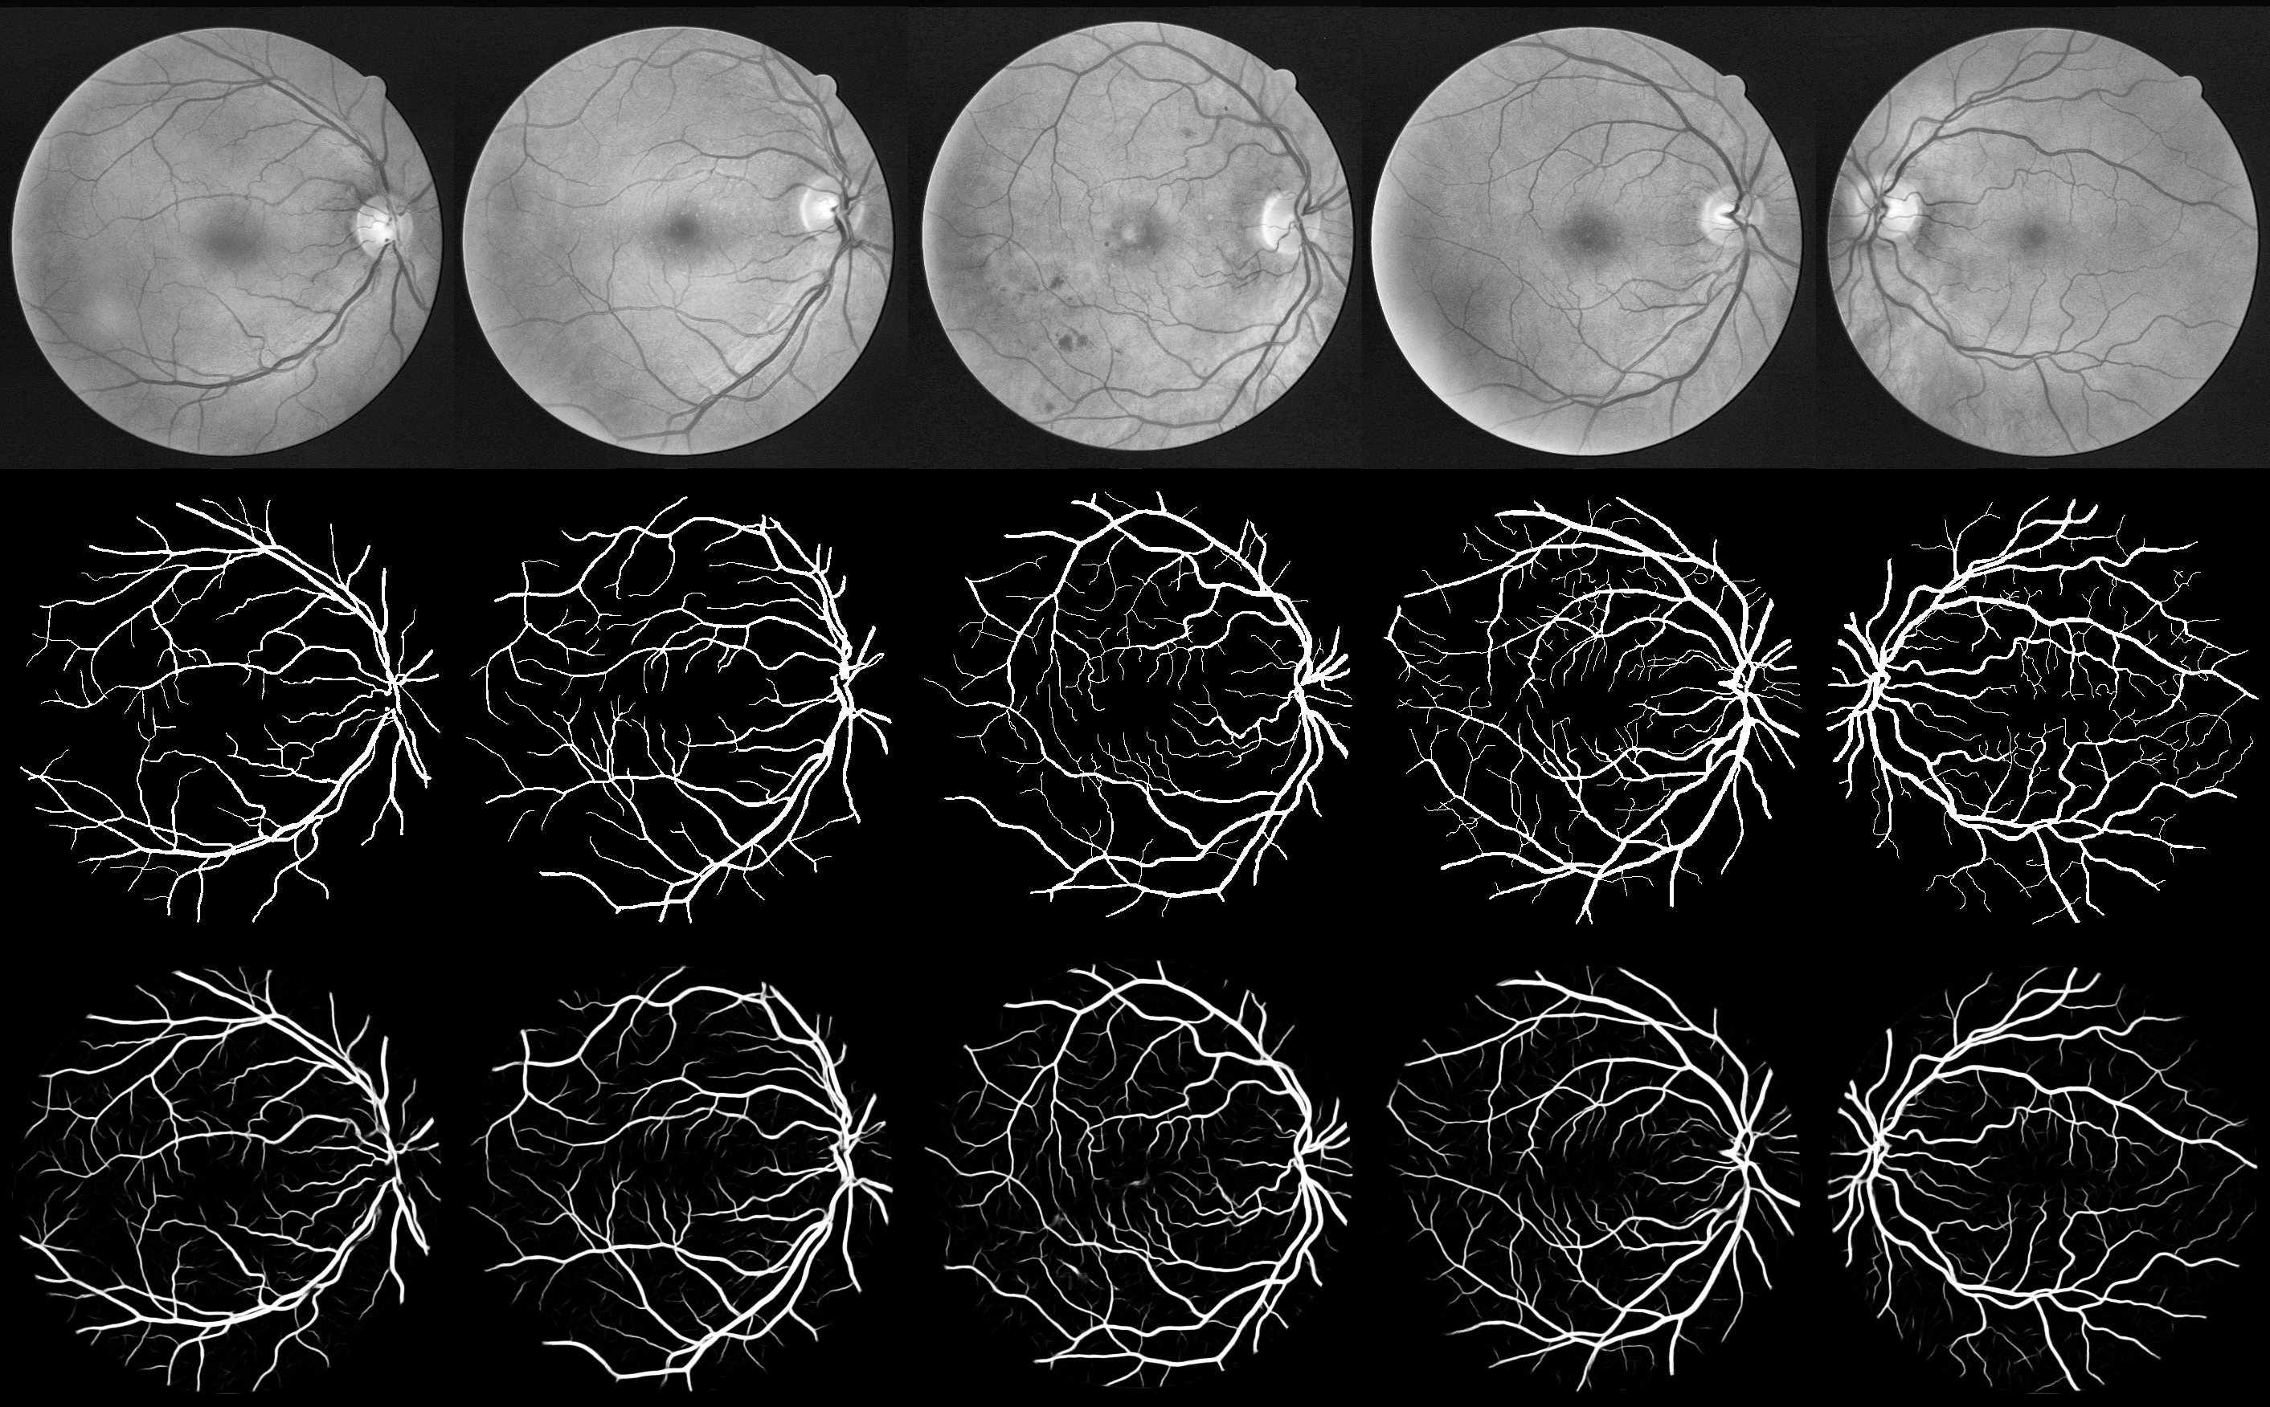
Qualitative Result

Slide 18

Thank You

